Slide 1
Introduction to Loops using Python
BY
Adnan Amin
Lecturer, IMSciences
adnan.amin@imsciences.edu.pk

Slide 2
Loops in python
A loop in programming language causes a statement or set of statements to execute repeatedly (again and again).
Programmers commonly have to write code that performs the same task over and over.
One way:
print(1)
print(2)
print(3)
….
….
….
print(1000)
Second way:
for i in range(1000):
print(i)

Slide 3
Condition-Controlled and Count-Controlled Loops
Broad categories of Loops:
Condition controlled
WHILE LOOP
Count controlled
FOR LOOP
uses a true/false condition to control the
number of times that it repeats.
repeats a specific number of times

Slide 4
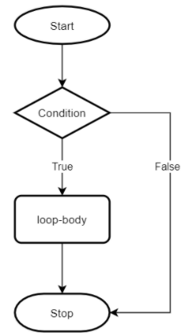
The while Loop
A condition-controlled loop causes a statement or set of statements to repeat as long as a condition is true.
It is used to iterate over a block of code as long as the test expression (condition) is true.
We generally use this loop when we don't know the number of times to iterate beforehand.
The while loop is known as a pretest loop, which means it tests its condition before performing an iteration.

Slide 5
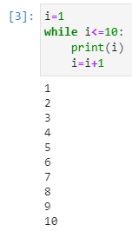
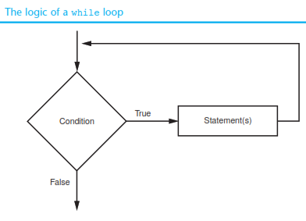
How while loop works
The while loop gets its name from the way it works: while a condition is true, do some task. The loop has two parts:
A condition that is tested for a true or false value.
A statement or set of statements that is repeated as long as the condition is true.
Python Syntax:
while condition:
statement-1
statement-2

Slide 6
Infinite while loop
How many times will 'Hello World’ be printed in the following program?
count = 10
while count < 1:
print('Hello World')

Slide 7
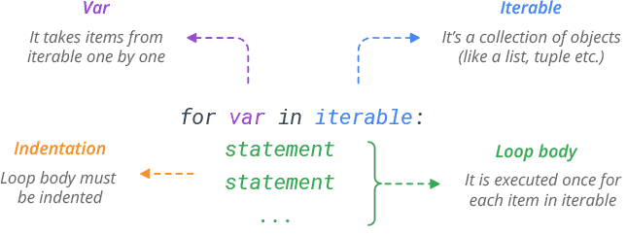
The for Loop
A count-controlled loop iterates a specific number of times.
for loops are traditionally used when you have a block of code which you want to repeat a fixed number of times.
for loops are used for iterating over a sequence (that is either a list, a tuple, a dictionary, a set, or a string).

Slide 8
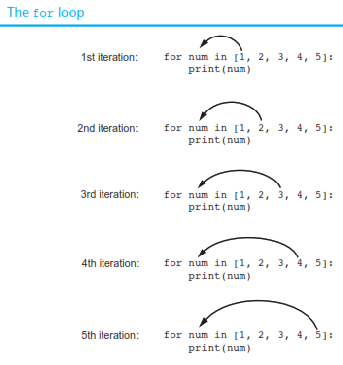
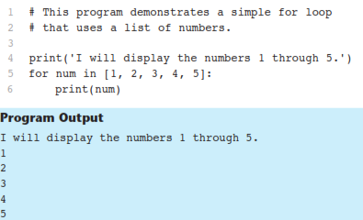
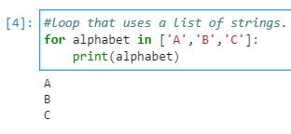
How for loop works

Slide 9
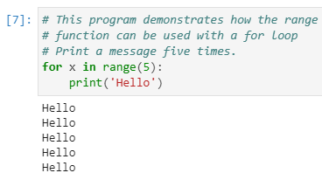
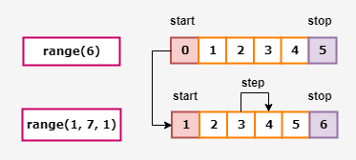
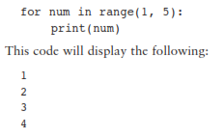

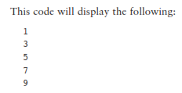
Using the range Function with the for Loop
range(start,stop,step)

Slide 10
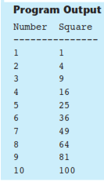
Find the square of first 11 integers
for number in range(1, 11):
square = number**2
print(number, '\t', square)

Slide 11
Nested Loop
A loop that is inside another loop is called a nested loop.
for minutes in range(60):
for seconds in range(60):
print(minutes, ':', seconds)
for hours in range(24):
for minutes in range(60):
for seconds in range(60):
print(hours, ':', minutes, ':', seconds)

Slide 12
Class Assignment-1
Write a program that uses nested loops to draw this pattern:
*******
******
*****
****
***
**
*

Slide 13
Class Assignment-2
Write a program that uses nested loops to draw this pattern:
##
# #
# #
# #
# #
# #

